Slide 1
Predicting Customer Churn for Telecom Companies
by
Sahith Todupunuri

Slide 2
BACKGROUND
The project aims to build a predictive model to identify customers who are most likely to churn in the near future
Understanding which customers are likely to churn can save a company significant amounts of money and allow them to take targeted actions to retain those customers.
In the context of telecom companies, churn means the rate at which customers discontinue their service subscriptions.

Slide 3
DATA SOURCE
The rows in the given table represent individual customer records in a telecom dataset.
Each row would contain data about a single customer's mobile usage, billing, and other account-related metrics
Data Size - 7 MB
Number of columns - 21
Number of rows - 7043

Slide 4
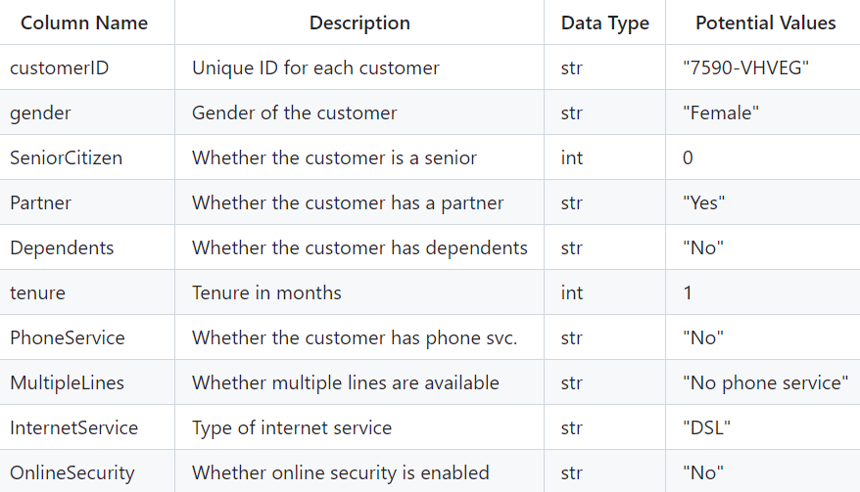
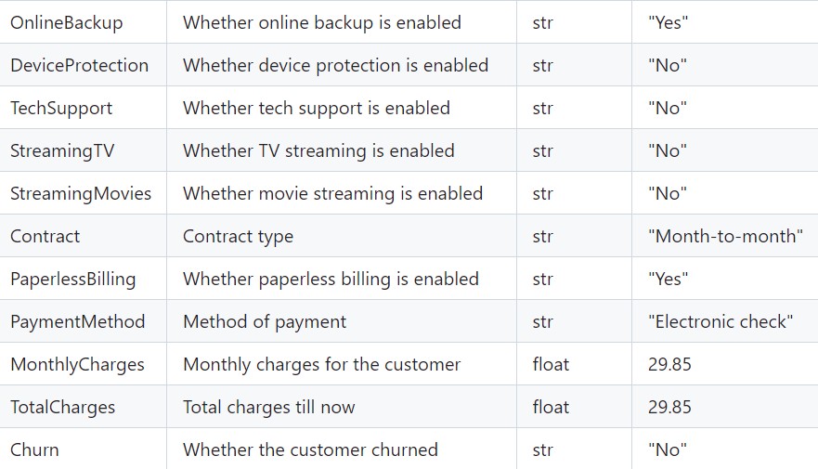
DATA DESCRIPTION

Slide 5
“Churn” will be our target variable in our ML model
“MonthlyCharges”, “TotalCharges”, “Tenure” variables maybe selected as predictors for ML model

Slide 6
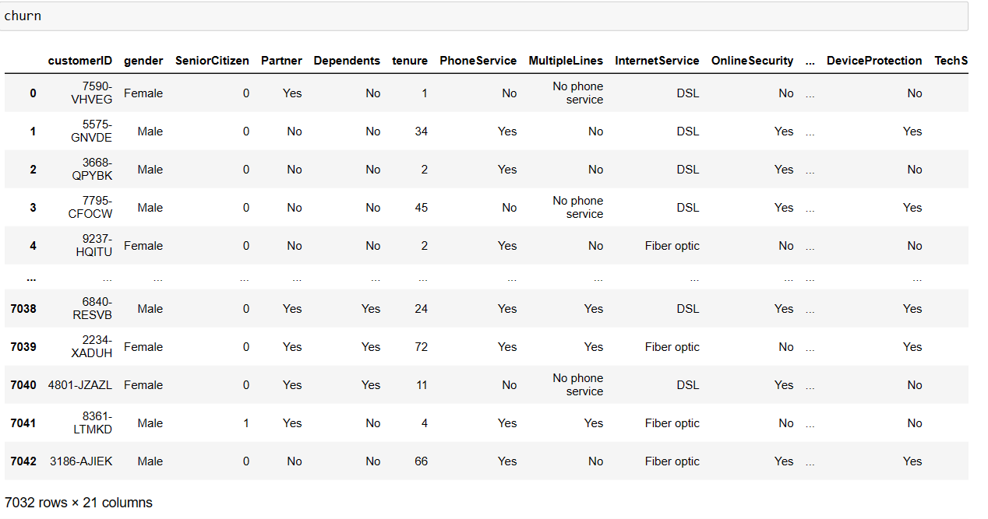
EXPLORATORY DATA ANALYSIS
Dataframe after removing all the missing values in Tenure Column

Slide 7
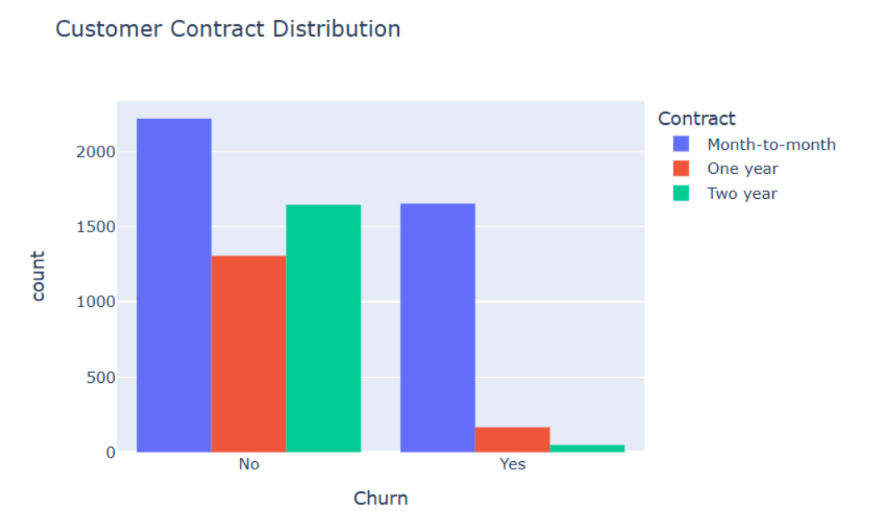
DATA VISUALIZATIONS
About 75% of customer with Month-to-Month Contract opted to move out as compared to 13% of customers with One Year Contract and 3% with Two Year Contract

Slide 8
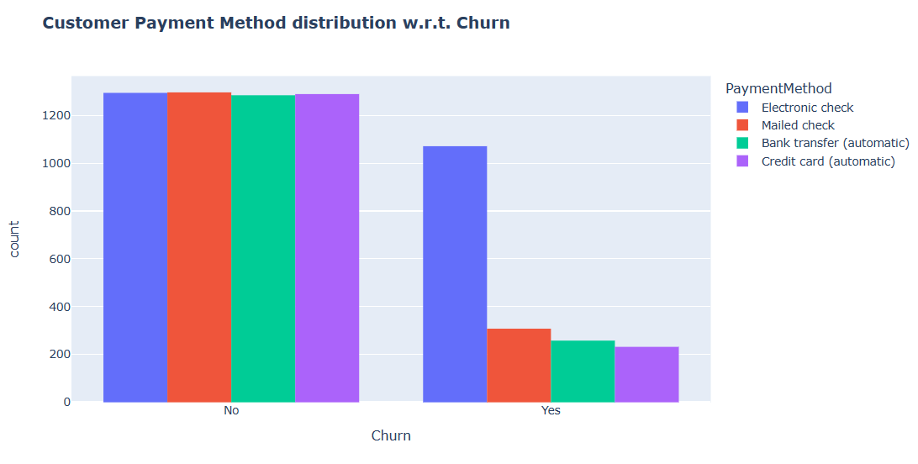
Customers who chose Electronic Check as their payment method were the most likely to leave, while those who selected Credit Card automatic transfer or Bank Automatic Transfer, as well as Mailed Check, were more likely to stay with the service.

Slide 9
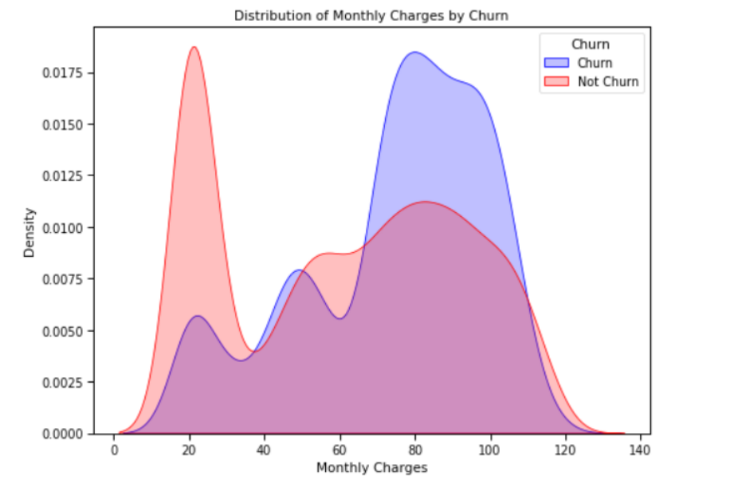

Slide 10
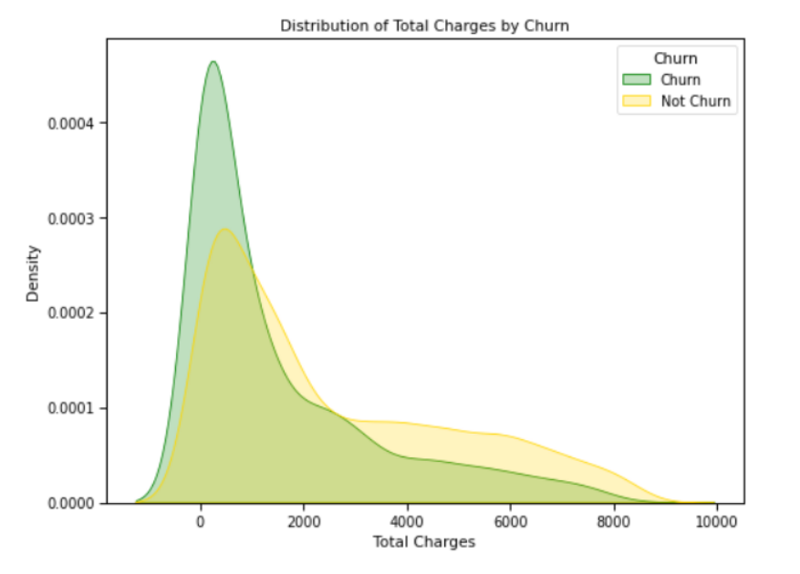

Slide 11
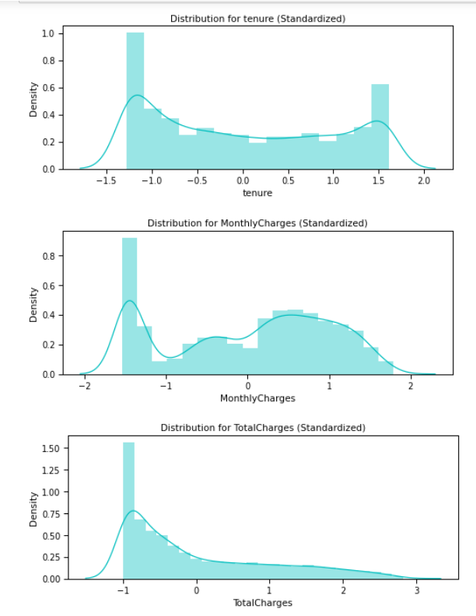
Standardizing Numeric Attributes

Slide 12
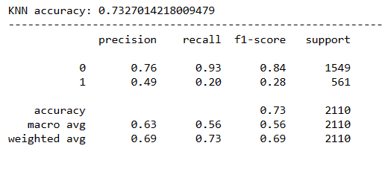
MODEL TRAINING
KNN

Slide 13
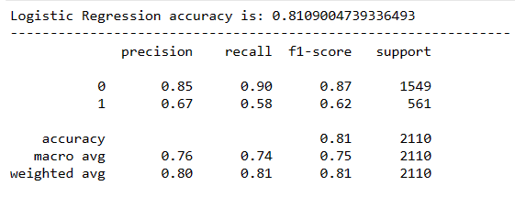
Logistic Regression

Slide 14
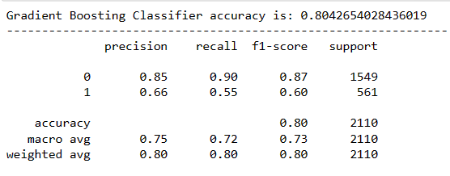
Gradient Boosting Classifier

Slide 15
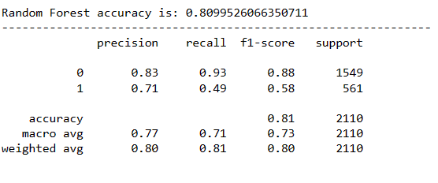
Random Forest

Slide 16
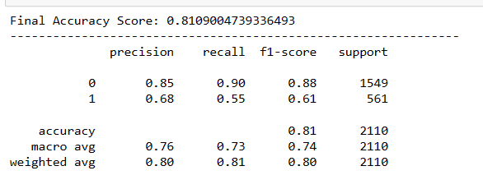
Voting Classifier

Slide 17
CONCLUSIONS
The Logistic Regression model achieved a higher accuracy compared to the other individual models, indicating its robustness in handling the dataset used.
Across all models, there is a consistently strong performance on the majority class (Class 0 - non-churn), as indicated by high precision and recall.
All models showed moderate success in identifying the minority class (Class 1 - churn), with room for improvement in both precision and recall for this group.
The Voting Classifier, which combines predictions from multiple models, did not significantly outperform the Logistic Regression model in terms of accuracy but provided a balanced approach to both classes.

